Slide 1
EagleSat-II
On Board Computer (OBC) Subsystem
Katherine Rocha

Slide 2
OBC Overview
Architecture Description
FPGA Fabric
MircoBlaze Soft Processing Core

Slide 3
Architecture Description
Centralized computer system
Triple Mode Redundancy solution to radiation
MicroBlaze SoftCore
Connects to all other subsystems, through FPGA Fabric
Processes all bus system data and telemetry
Communicates with the ground through COMMS subsystem

Slide 4
FPGA Fabric – Overview
Ease of development for the team is critically important
FPGA with softcore to meet instrument timing requirements

Slide 5
FPGA Fabric – Firmware
Ease of development is a priority
Software being developed by each subteam semi-independently

Slide 6
FPGA Fabric – Additional Telemetry
Comms Packet Handling
Packetizes data and telemetry for downlink asynchronously

Slide 7
MicroBlaze Softcore – Overview
Interfaces with all other bus systems and payload stack
Receives and interprets commands from the ground
Designed in house
Custom development for mission-critical system
Real-Time Processor Preset Configuration
Operating System TBD
Flight SW Framework TBD

Slide 8
MicroBlaze – Firmware
Using Xilinx IP and example code to create the softcore
External interfaces adjusted to work with Neso Artix 7
Custom PDL with interfaces to FPGA
Off-loading processing to FPGA fabric

Slide 9
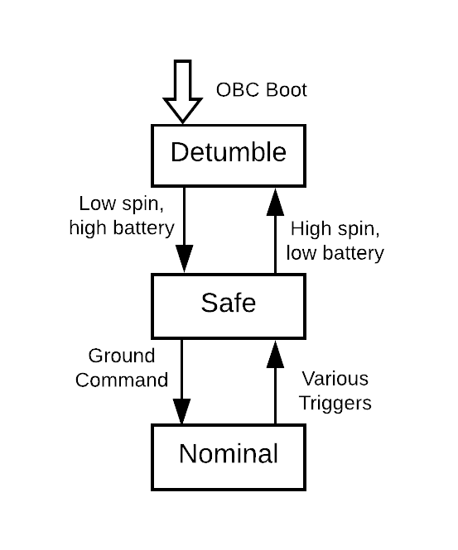
MicroBlaze Software – Operating Modes
Detumble
Entered at every boot, all subsystems off except OBC and ACS
ACS detumbling the spacecraft until low rotation rate
Safe mode
Spacecraft reduced to barebones operation
Payloads off, COMMS attempts to establish communication with ground station
Normal operating mode
Main science mission underway
Payloads fully operating, ACS stationkeeping
Figure 7: EagleSat-II Operating Modes

Slide 10
On-Board Computer – Board Design
Prototype PCB early in design/build process
Parts and interfaces selected, early schematic designs
Pin and peripheral assignments planned, subject to change
MDE prototype already running on TM4C
Black box test of descaled system during high-altitude balloon flight
Possible migration to FPGA
CRP prototype in development
MCU + FPGA development difficult – difficult to test either until both complete
Prototype Complete – testing being done with radiation sources

Slide 11
Questions?

